Slide 1
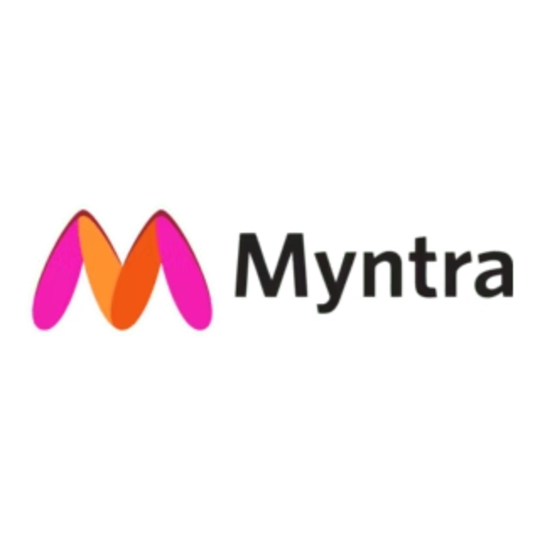
MyPulse 9.0 – Employee Engagement Analysis
Across 5 Business Units – Quantitative + Qualitative Insights
Prepared by: Riya A | December 2025

Slide 2
The Business Challenge
The Reality
Financial Impact
Productivity Loss
Engagement scores vary dramatically across business units, creating significant business impact and unclear paths forward.
High attrition costs ₹40-50L annually in replacement and training expenses
Low engagement correlates with 21% lower productivity across teams
Root Causes
Unclear drivers behind performance differences between units
The Question: What's really driving these differences, and how do we fix it?

Slide 3

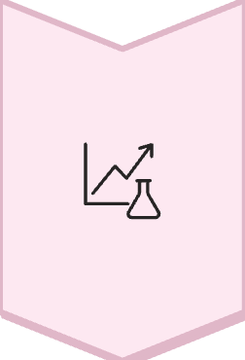


A Mixed-Methods Approach
Combining quantitative survey data with qualitative insights to understand not just what the scores show, but why employees feel the way they do.
Analyze the Data
760 employees tracked across 3 quarters, examining 8 key engagement dimensions
Listen to Employees
24 focus group participants across 3 facilitated sessions sharing real experiences
Connect the Dots
Numbers combined with stories reveal actionable insights and clear solutions

Slide 4
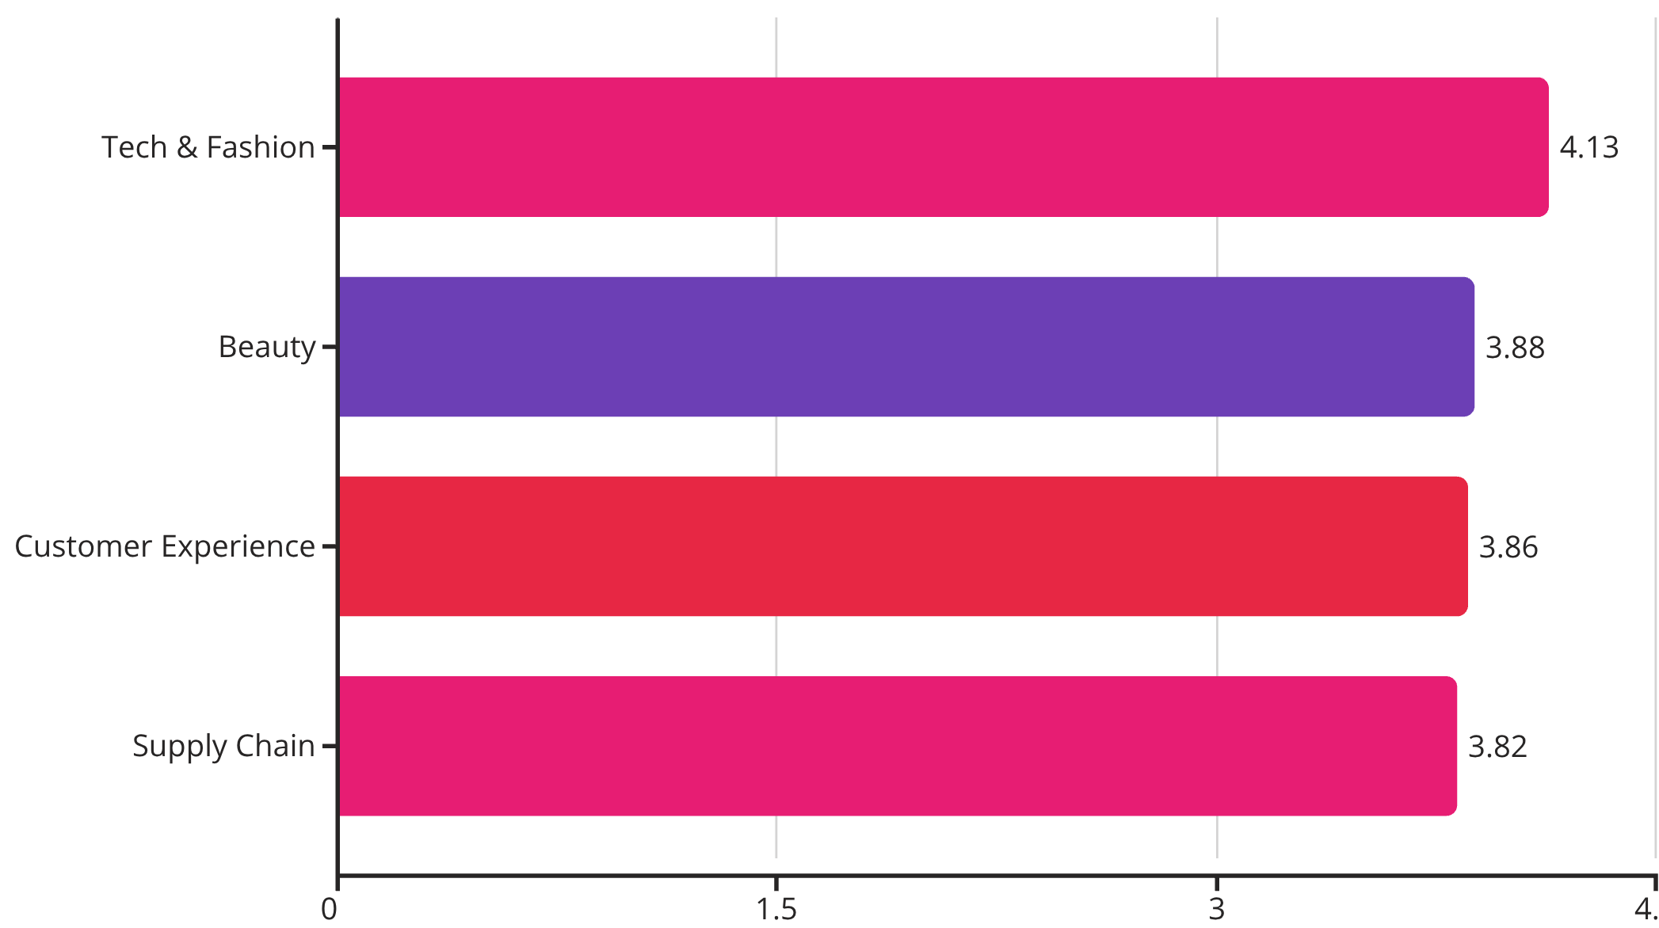

The Scores Revealed a Pattern
Quantitative analysis uncovered significant variations in engagement across business units, but the numbers alone couldn't explain the underlying causes.
The 0.31 Point Gap: Tech and Fashion BUs significantly outperformed other units, but understanding why required deeper investigation beyond the numbers.

Slide 5



What Employees Actually Said
"I don't see a clear path to the next level. Promotions feel unclear."
18 of 24 employees (75%) expressed this concern across all business units
When focus groups revealed that three-quarters of participants cited the same issue regardless of their business unit, it validated what the quantitative data suggested: career development represents a systemic challenge, not an isolated problem.
3.61
Career Growth
Lowest scoring dimension

Slide 6
The Breakthrough Insight
The gap isn't about function—it's about systems
Tech BU: High Performers (4.13)
Other BUs: Lower Scores (3.82-3.88)
Documented Frameworks
No Documentation
Clear career progression frameworks that employees can reference
Career paths exist informally but aren't written down or standardized
Transparent Criteria
Unclear Standards
Employees understand exactly what each level requires for advancement
Promotion criteria vary by manager and lack consistent definition
Multiple Pathways
Missing Structure
Well-defined IC vs Management tracks provide choice and clarity
No formal frameworks to guide employee development decisions
Key Discovery: Tech BU wasn't scoring higher because of the nature of engineering work—they were outperforming because they built systematic career development infrastructure that other units lacked.

Slide 7
The Solution: Career Pathing Program
1
2
3
Adapt Proven Model
Define Clear Levels
Build Skill Matrices
Take Tech BU's successful framework and customize it for Supply Chain, Fashion, Beauty, and Customer Experience functions
Create E1-E5 level definitions for every role, establishing transparent expectations and progression criteria
Document specific competencies and skills required at each level to guide employee development
4
5
Enable Self-Assessment
Launch Workshops
Provide tools for employees to evaluate their current level and identify gaps to close
Conduct career development workshops to educate employees and managers on using the new frameworks

Slide 8

Evidence-Based Confidence
This recommendation is grounded in internal proof points, employee demand, strong financial returns, and industry best practices from leading tech companies.
Internal Validation
Compelling ROI
Tech BU's 4.13 score proves the framework drives measurable results
Total Investment
Employee Demand
Framework development and training costs
75% of focus group participants explicitly requested clearer career paths
Quick Wins
Annual Return
90-day pilot timeline enables rapid testing and iteration before full rollout
Retention and productivity savings
Industry Standard
ROI Ratio
Google, Amazon, and Spotify all use similar career leveling frameworks successfully
Every rupee invested returns five

Slide 9

90-Day Action Plan
A phased approach enables rapid implementation while allowing for feedback and refinement before company-wide deployment.
Month 1: Design & Align
Month 3: Measure & Iterate
Adapt Tech framework for Supply Chain and Fashion business units
Track percentage of employees with documented career development plans
Train managers on conducting effective career development conversations
Gather participant feedback and identify improvement opportunities
Create self-assessment tools and supporting documentation
Refine approach based on pilot results and prepare for scale
1
2
3
Month 2: Pilot Launch
Roll out career frameworks in two pilot business units
Begin career development workshops with employees and managers
Establish feedback mechanisms to capture learnings
By Q2 2025: Complete company-wide rollout across all business units, establishing career pathing as a core element of Myntra's employee experience.

Slide 10
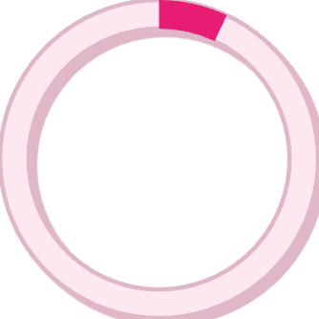

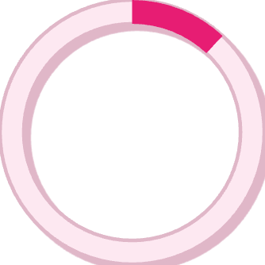
Projected Impact
6-Month Targets
Beyond the Numbers
Career Growth
Clear Development Paths
3.61 → 3.85 score increase
Every employee understands how to grow their career at Myntra
7%
Manager Enablement
Overall Engagement
Leaders have structured frameworks to coach and develop their teams effectively
3.93 → 4.05 score improvement
3%
Competitive Advantage
Stronger employer brand in competitive talent markets attracts top performers
Attrition Reduction
Voluntary turnover decrease
12%
Growth Culture
Organization-wide commitment to employee development becomes embedded in operations
Value Created: ₹50L+ in retention savings, plus increased productivity and reduced recruitment costs

Slide 11



Thank YOU
Open to Questions and Feedback
Github Link: Website Link:
Prepared by: Riya A | December 2025

